Slide 1
STACKS

Slide 2
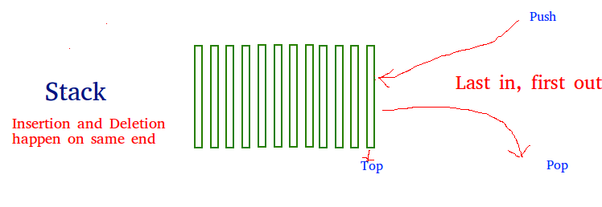
Stack is a linear data structure which follows a particular order in which the operations are performed. The order may be LIFO(Last In First Out) or FILO(First In Last Out).
There are many real-life examples of a stack. Consider an example of plates stacked over one another in the canteen. The plate which is at the top is the first one to be removed, i.e. the plate which has been placed at the bottommost position remains in the stack for the longest period of time. So, it can be simply seen to follow LIFO(Last In First Out)/FILO(First In Last Out) order.

Slide 3
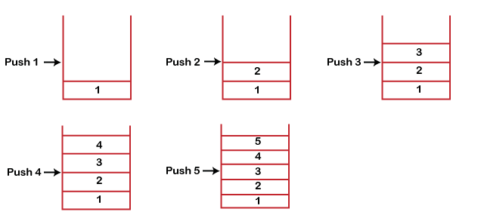
It contains only one pointer top pointer pointing to the topmost element of the stack. Whenever an element is added in the stack, it is added on the top of the stack, and the element can be deleted only from the stack. In other words, a stack can be defined as a container in which insertion and deletion can be done from the one end known as the top of the stack.
Working of Stack
Stack works on the LIFO pattern. As we can observe in the below figure there are five memory blocks in the stack; therefore, the size of the stack is 5.
Suppose we want to store the elements in a stack and let's assume that stack is empty. We have taken the stack of size 5 as shown below in which we are pushing the elements one by one until the stack becomes full.

Slide 4
When we perform the delete operation on the stack, there is only one way for entry and exit as the other end is closed. It follows the LIFO pattern, which means that the value entered first will be removed last. In the above case, the value 5 is entered first, so it will be removed only after the deletion of all the other elements.
The following are some common operations implemented on the stack:
push(): When we insert an element in a stack then the operation is known as a push. If the stack is full then the overflow condition occurs.
pop(): When we delete an element from the stack, the operation is known as a pop. If the stack is empty means that no element exists in the stack, this state is known as an underflow state.
isEmpty(): It determines whether the stack is empty or not.
isFull(): It determines whether the stack is full or not.

Slide 5
PUSH operation
The steps involved in the PUSH operation is given below:
Before inserting an element in a stack, we check whether the stack is full.
If we try to insert the element in a stack, and the stack is full, then the overflow condition occurs.
When we initialize a stack, we set the value of top as -1 to check that the stack is empty.
When the new element is pushed in a stack, first, the value of the top gets incremented, i.e., top=top+1, and the element will be placed at the new position of the top.
The elements will be inserted until we reach the max size of the stack.

Slide 6
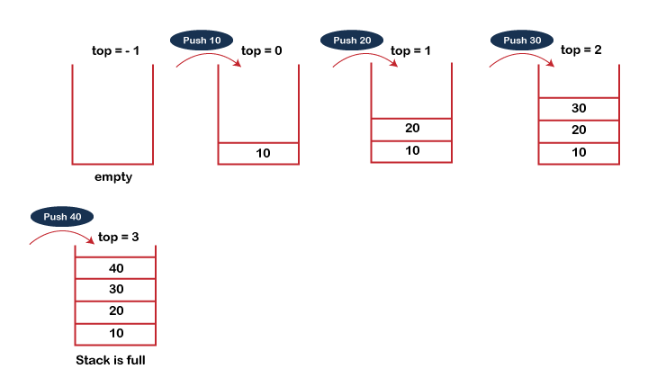
POP operation
The steps involved in the POP operation is given below:
Before deleting the element from the stack, we check whether the stack is empty.
If we try to delete the element from the empty stack, then the underflow condition occurs.
If the stack is not empty, we first access the element which is pointed by the top.
Once the pop operation is performed, the top is decremented by 1, i.e., top=top-1.

Slide 7
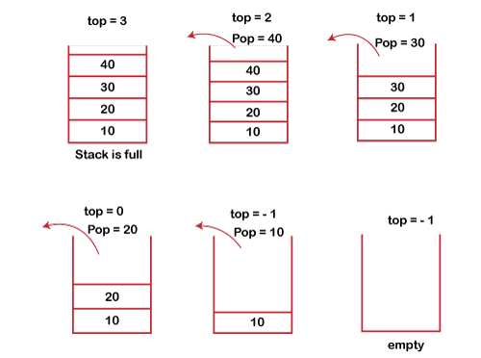

Slide 8
Array implementation of Stack
Adding an element onto the stack (push operation)
Adding an element into the top of the stack is referred to as push operation. Push operation involves following two steps.
Increment the variable Top so that it can now refer to the next memory location.
Add element at the position of incremented top. This is referred to as adding new element at the top of the stack.
void push (int val, int n) //n is size of the stack
{
if (top == n )
printf("\n Overflow");
else
{
top = top +1;
stack[top] = val;
}
}

Slide 9
Deletion of an element from a stack (Pop operation)
int pop ()
{
if(top == -1)
{
printf("Underflow");
return 0;
}
else
{
return stack[top - - ];
}
}
void show()
{
for (i=top;i>=0;i--)
{
printf("%d\n",stack[i]);
}
if(top == -1)
{
printf("Stack is empty");
}
}

Slide 10
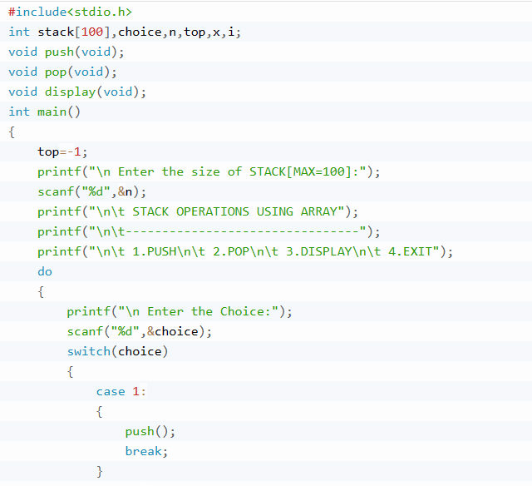

Slide 11
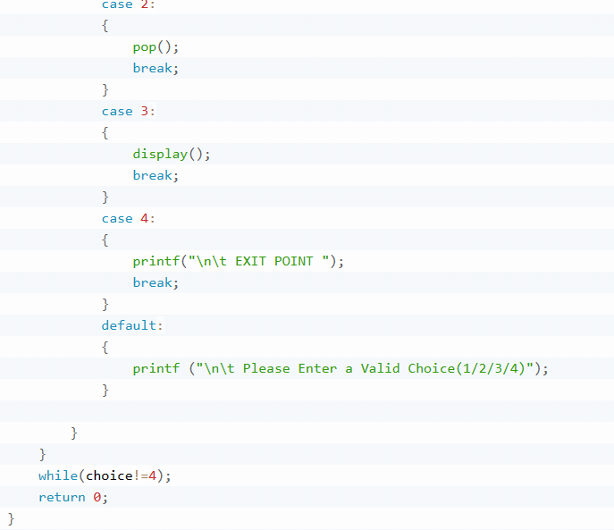

Slide 12
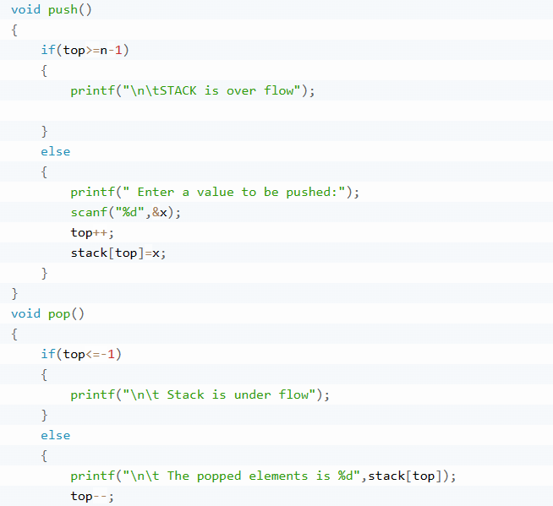

Slide 13
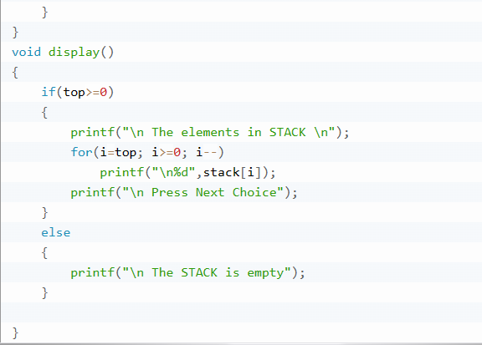

Slide 14
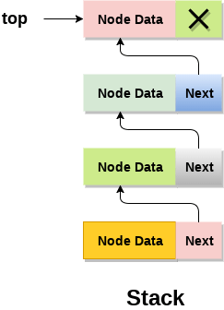
Linked list implementation of stack
Instead of using array, we can also use linked list to implement stack. Linked list allocates the memory dynamically. However, time complexity in both the scenario is same for all the operations i.e. push, pop and peek.
In linked list implementation of stack, the nodes are maintained non-contiguously in the memory. Each node contains a pointer to its immediate successor node in the stack. Stack is said to be overflown if the space left in the memory heap is not enough to create a node.
The top most node in the stack always contains null in its address field.

Slide 15
Adding a node to the stack (Push operation)
In order to push an element onto the stack, the following steps are involved:
1. Create a node first and allocate memory to it.
2. If the list is empty then the item is to be pushed as the start node of the list. This includes assigning value to the data part of the node and assign null to the address part of the node.
3. If there are some nodes in the list already, then we have to add the new element in the beginning of the list (to not violate the property of the stack). For this purpose, assign the address of the starting element to the address field of the new node and make the new node, the starting node of the list.

Slide 16
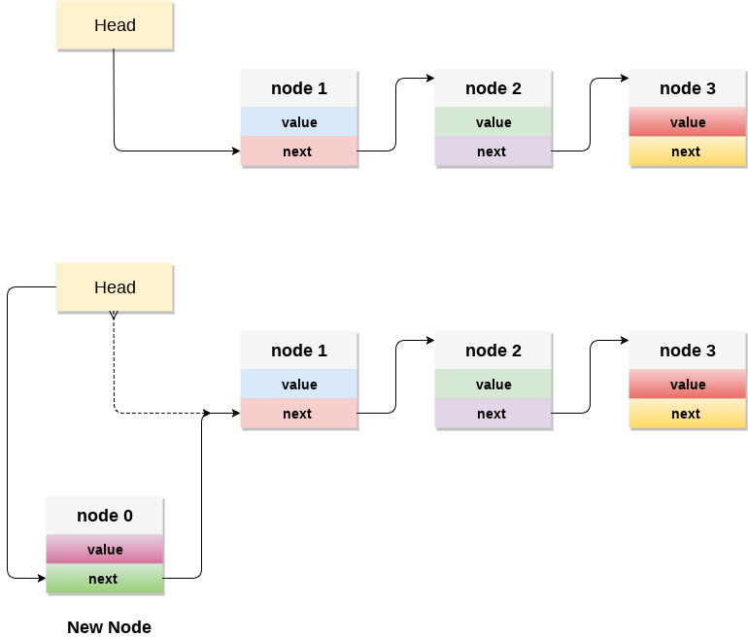

Slide 17
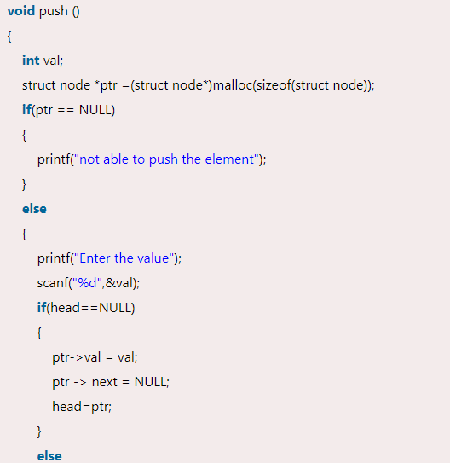
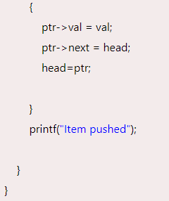

Slide 18
Deleting a node from the stack (POP operation)
In order to pop an element from the stack, we need to follow the following steps :
1. Check for the underflow condition: The underflow condition occurs when we try to pop from an already empty stack. The stack will be empty if the head pointer of the list points to null.
2. Adjust the head pointer accordingly: In stack, the elements are popped only from one end, therefore, the value stored in the head pointer must be deleted and the node must be freed. The next node of the head node now becomes the head node.

Slide 19
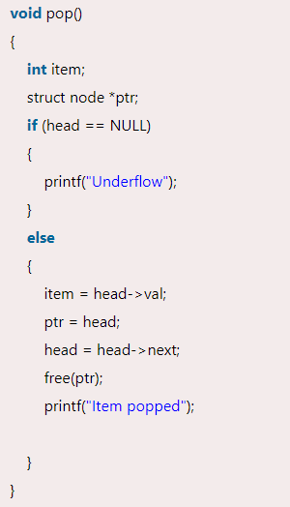

Slide 20
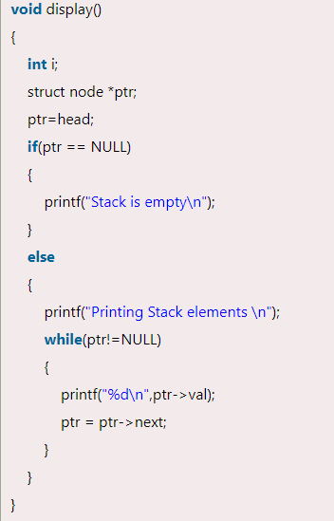
Display the nodes (Traversing)
Displaying all the nodes of a stack needs traversing all the nodes of the linked list organized in the form of stack. For this purpose, we need to follow the following steps.
1. Copy the head pointer into a temporary pointer.
2. Move the temporary pointer through all the nodes of the list and print the value field attached to every node.

Slide 21
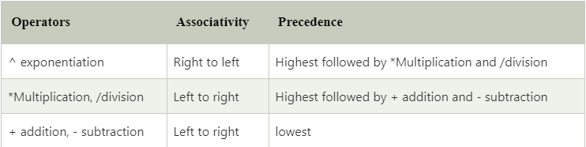
Applications of Stacks:
Evaluation of Arithmetic Expressions
Backtracking - Backtracking is another application of Stack. It is a recursive algorithm that is used for solving the optimization problem.
Delimiter Checking
Reverse a Data
Processing Function Calls
To evaluate the expressions, one needs to be aware of the standard precedence rules for arithmetic expression. The precedence rules for the five basic arithmetic operators are:
There are three notations to represent an arithmetic expression:
Infix Notation
Prefix Notation
Postfix Notation

Slide 22
